Slide 1
Optimizing Revenue Leakage & Profitability in the Hospitality Sector
By-Sunny Kumar

Slide 2
Executive Summary
This project aims to identify revenue leakage, underutilization, and optimization opportunities across seven properties owned by Atliq Hotels. By analyzing booking, revenue, and operational data, we developed strategic recommendations to increase profitability, reduce cancellations, and improve guest satisfaction.
Four major strategies were implemented:
1)Dynamic pricing & bundling (Atliq Blu, Bay)
2)Operational improvements (Atliq Seasons, Grands)
3)Forecasting & scenario analysis for business planning
4)Expansion modeling for Atliq Seasons in new cities
Impact: ₹2.08 Cr to ₹4.13 Cr net revenue increase across 4 properties with ~₹69.5L investment.

Slide 3
Project Components :
Root Cause Analysis
Consulting Recommendation
Business Justification

Slide 4
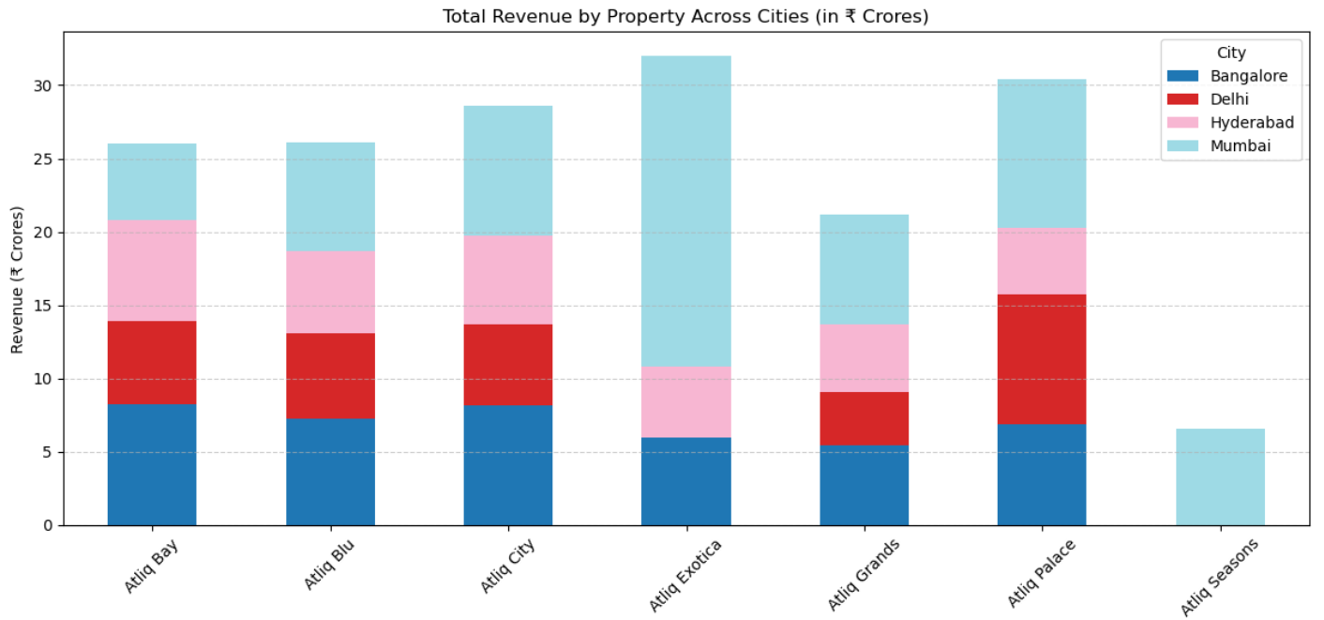
Root Cause Analysis :
Atliq Exotica leads in overall revenue:
Highest total revenue (~₹32 Cr), with Mumbai alone contributing more than 60%.
This shows strong performance and brand recognition in Mumbai.
Atliq Seasons is underperforming:
Lowest revenue (~₹6.5 Cr) and only present in Mumbai.
This suggests either limited reach or low demand; highlights the need for expansion and operational optimization.
Mumbai is the highest revenue-generating city:
Major contributor across almost all properties (especially Exotica, Palace, and City).
Mumbai’s consistent dominance suggests focus on premium pricing and bundle strategies here can yield strong ROI.

Slide 5
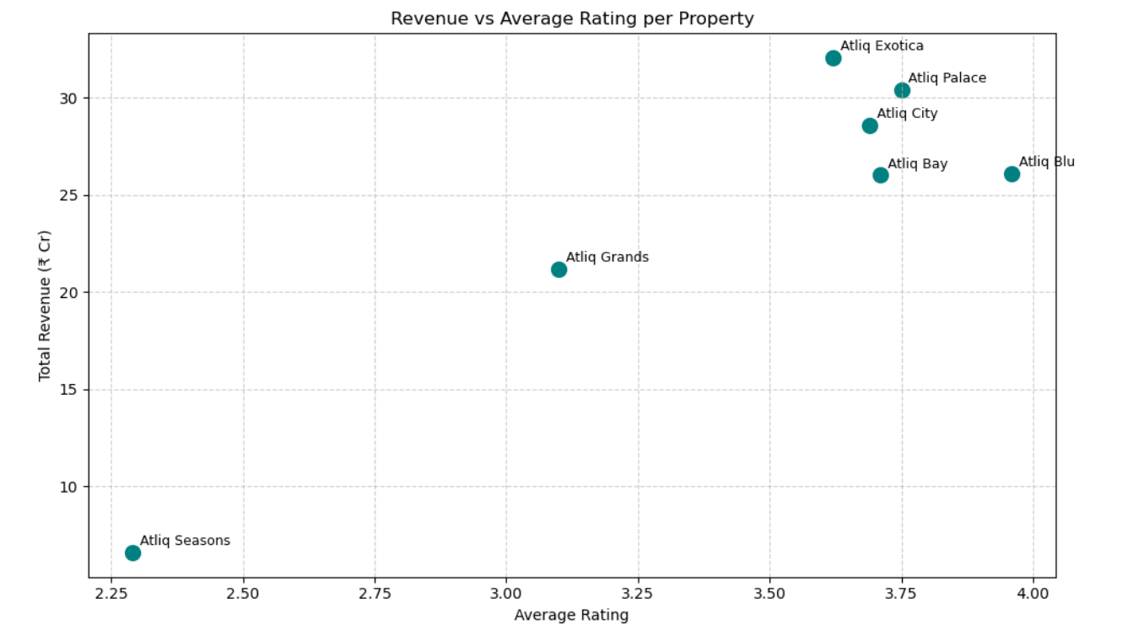
Root Cause Analysis :
Pattern | Interpretation
⬆ Rating + ⬆ Revenue | Ideal: well-rated & high-performing
⬆ Rating + ⬇ Revenue | Underpriced or underpromoted
⬇ Rating + ⬆ Revenue | Overpriced or forced sales (fix service)
⬇ Rating + ⬇ Revenue | Poor performers — target for overhaul
Most Atliq properties cluster around 3.6–3.9 ratings with high revenues. Atliq Seasons stands out as an outlier: it has very low guest satisfaction (2.29) and very low revenue (₹6.6 Cr), indicating both brand risk and financial underperformance.
“Atliq Grands is underperforming on volume despite strong pricing per guest. The rating of 3.1 suggests service quality may be a bottleneck. With competitive revenue per booking, it's a strong candidate for experience improvement rather than repositioning.”

Slide 6
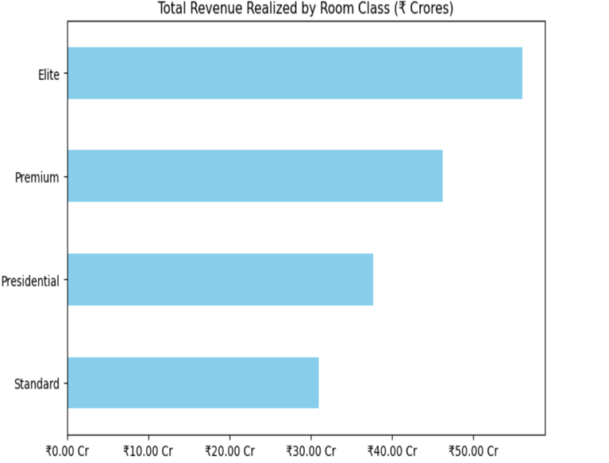
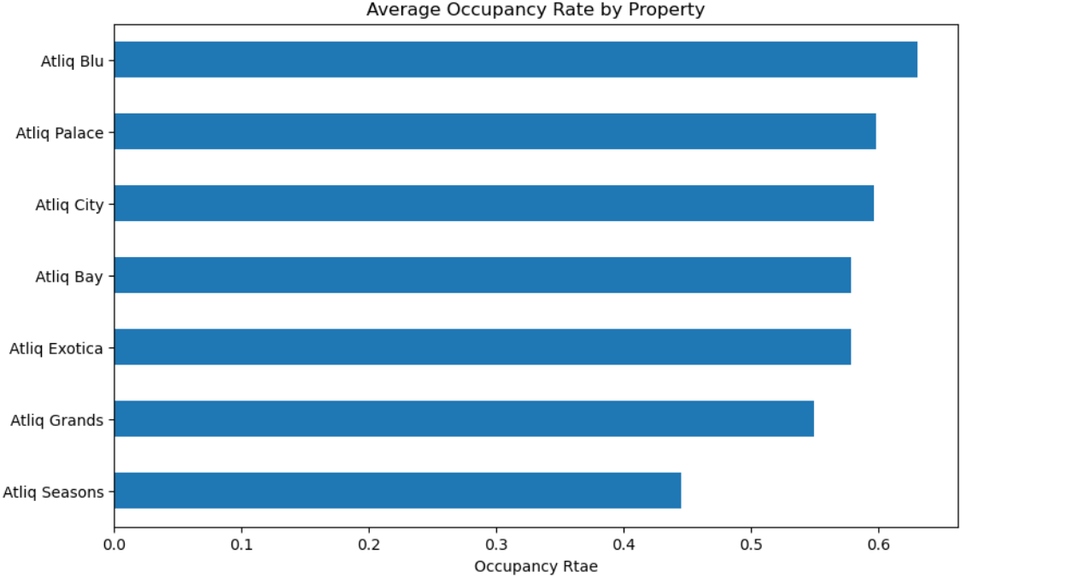
Atliq Blu leads in occupancy:
Highest average occupancy rate (~63%)
Reflects strong demand and efficient space utilization.
Suitable for price optimization or premium bundling.
Atliq Seasons is underperforming:
Lowest occupancy rate (~44%), well below the portfolio average.
Indicates serious underutilization — requires immediate operational and marketing interventions.
Justifies need for housekeeping fixes, customer experience revamp, or repositioning
Internal analysis shows that while pricing remains competitive in lower-tier rooms (Standard, Elite), upper-tier categories (Premium, Presidential) are priced above perceived value.

Slide 7
SWOT Analysis :
Strength
Weakness
Opportunity
Threat
✔ Strong occupancy in key properties (Bay, Blu)
✔ High Rev/Booking in Seasons & Exotica
✔ Consistent revenue from top 4 hotels
❌ Low guest ratings in Seasons & Grands
❌ No presence of Seasons outside Mumbai
❌ Revenue leakage from cancellations & no-shows
⭐ Expand high-value brands (Seasons) to new cities
⭐ Implement dynamic pricing & bundling offers
⭐ Recover lost revenue from improved ratings
⚠ Competitor pricing pressure on Palace, Blu, Bay
⚠ Rising operational costs (staffing, housekeeping)
⚠ Dependency on weekends for 50% of revenue

Slide 8
Consulting Recommendation :
“Based on occupancy trends and revenue leakage, we propose a targeted pricing uplift, dynamic staffing, and bundling strategy.”
Element | Description
🎯 Goal | Measure impact of price uplift + bundling on revenue, occupancy, and ratings
🧪 Test Group | Cities like Mumbai, Bangalore (high booking volume, stable demand)
⚖️ Control Group | Similar cities without price changes (e.g., Delhi, Hyderabad)
⏱️ Duration | 4–6 weeks (covers seasonal variation & weekends)
📊 Metrics to Track | - Revenue per booking - Total revenue - Occupancy % - Cancellation rate - Guest ratings
🧪 A/B Testing Plan – Controlled Rollout of Pricing Strategy Minimizing risk while validating real-world ROI impact
(For Properties –Atliq Bay and Atliq Blu)
🧠 Insights
Metric | Test Group Avg | Control Group Avg | Insights
Bookings | 37,735 | 29,560 | ✅ Higher demand in test cities
Revenue | ₹54.45 Cr avg | ₹30.99 Cr avg | ✅ Stronger revenue from test cities
Ratings | 3.53 | 3.72 | ⚠️ Slightly lower satisfaction in test group

Slide 9
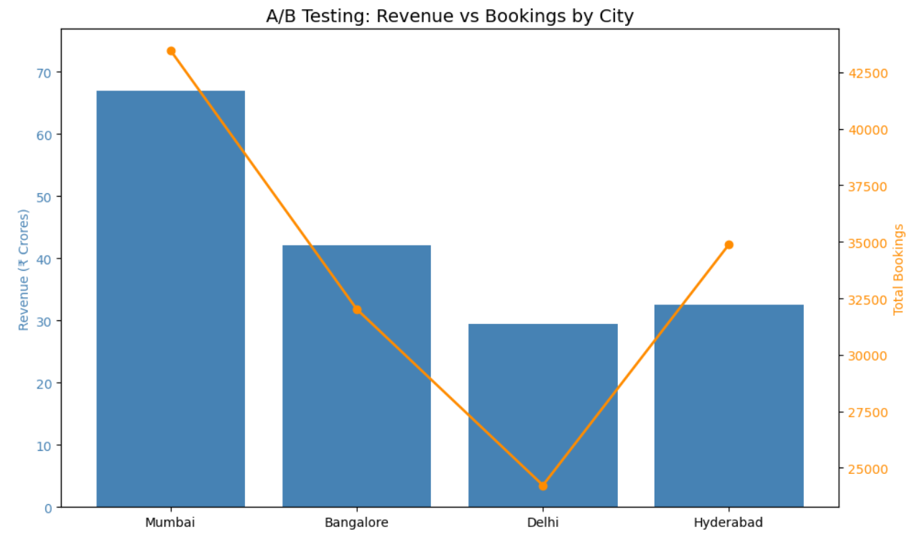
Hotel | City | Uplift Test | Reason
Bay | Bangalore | ✅ Yes (5% or 10%) | Strong booking base + growth potential
Bay | Mumbai | ❌ No | Low volume, risk of underutilization
Blu | Mumbai + Bangalore | ✅ Yes | Already strong base in both cities
Price uplift was approved for properties with strong booking volumes and high occupancy—Bay (Bangalore) and Blu (Mumbai & Bangalore)
Bay (Mumbai) was excluded due to low demand, to avoid further underutilization.

Slide 10
🧪 PILOT TEST MODEL – Atliq Seasons & Grands
🎯 Objective:
To test whether introducing Atliq Seasons (currently only in Mumbai) and optimizing Atliq Grands in select cities with bundling and pricing strategy can increase revenue & guest satisfaction.
Step-by-Step Pilot Plan
Step | Action
1️⃣ Select Pilot Cities | Choose cities with strong hotel demand: ✅ Delhi, ✅ Bangalore, ✅ Hyderabad
2️⃣ Launch Format | - Atliq Seasons: New city entry - Atliq Grands: Optimization in same
3️⃣ Define Bundles | 🎁 Premium Room + Breakfast + Free Wi-Fi 🎁 Family Bundle: 2 Meals + Laundry + Kid’s Offer
4️⃣ Set Pilot Price | Keep uplift at 5–10%, elasticity assumed at –0.6
5️⃣ Track KPIs | - Bookings - Revenue - RevPAR - Ratings - Cancellation Rate
6️⃣ Duration | Run for 4–6 weeks, covering weekend & weekday traffic
7️⃣ Compare | Compare with baseline properties in non-pilot cities using A/B metrics
8️⃣ Decision Gate | If bookings hold ≥90% and revenue ↑ → Rollout across more cities
✅ Phase 1: Fix Foundation – Improve Ratings
Focus Area | Action Items | Owner/Dept
⭐ Guest Experience | - Address cleanliness & housekeeping issues - Staff training - Improve check-in/out process | Ops + HR
🛏️ Amenities | - Add complimentary WiFi, breakfast - Offer basic wellness perks | Product / GM
📢 Feedback Loop | - Launch in-room QR feedback - Respond to online reviews fast | Marketing
🎯 Target: Improve rating from 2.29 → 3.5+ within 2–3 months

Slide 11
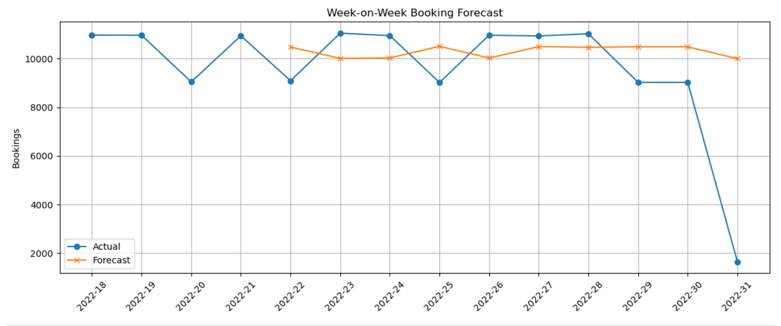
✅ Phase 2: Brand Repositioning & Marketing
✅ Phase 3: Market Expansion (Pilot in 3 Cities)
City | Launch Plan
Delhi | High volume, price-tolerant customers
Bangalore | Strong tech/corporate crowd, good ADR
Hyderabad | Mid-volume, family-friendly test market
Strategy | Execution
🎯 Rebranding | Refresh positioning as “affordable-luxury with premium comfort”
📢 Local Campaigns | Google + Meta ads targeting couples, weekend getaways
🌐 Booking Platforms | Highlight perks on MMT, Goibibo, Agoda
⭐ Loyalty Boost | Partner with influencers or bundle loyalty cashback
🎯 Build brand trust before launching in new markets
Launch with bundles (e.g., breakfast + WiFi + late checkout)
Target ₹15–20 Cr additional annual revenue
Use WoW forecast model to track bookings vs. expectation
📈 Forecasted Benefits (Year 1)
Metric | Current (1 City) | Target (4 Cities) | Gain
Revenue | ₹6.6 Cr | ₹22–25 Cr | ✅ 3x–4x
Rating | 2.29 | ≥ 3.5 | ✅ Brand-safe
Booking Reach | 3,900 | ~13,000 | ✅ Growth
RevPAR | ₹4,000+ | Hold / increase | ✅ Margin-safe

Slide 12
Insight 1: Weekend Booking Density = 2.5× Weekday
➡️ Weekend days handle 2.5× more bookings per day than weekdays.
Day Type | Total Bookings (%) | Days in Category | Bookings per Day
Weekdays | 50% | 5 (Mon–Fri) | 10% per day
Weekends | 50% | 2 (Sat–Sun) | 25% per day
Insight 2: Service Quality Issues at Seasons & Grands
Property | Avg Rating | Revenue per Booking (₹) | Interpretation
Atliq Seasons | 2.29 | ₹16,606 | 🚨 Very poor experience despite high price
Atliq Grands | 3.10 | ₹12,417 | Below standard; suggests service inconsistencies
🧹 Housekeeping: Improve Quality Standards
👥 Staffing: Weekend Optimization
Recommendation | Justification
Conduct daily room checks before guest check-in | Poor reviews at Seasons demand strict QC
Retrain staff at Seasons and Grands on cleaning & hospitality | Needed to reach 3.5+ ratings benchmark
Implement digital feedback in rooms (QR or SMS) | Capture real-time service issues
Use SOP checklists for linen, bathrooms, amenities | Standardize quality across shifts
Recommendation | Justification
Increase front desk & housekeeping headcount by 25–30% on weekends | Weekend load is 2.5× higher per day
Stagger shift start times (morning check-out vs. evening check-in) | Improves turnaround and reduces guest waiting
Hire flexible/part-time staff for Fri–Sun | Cuts weekday idle labor cost
Use booking forecasts to plan rosters dynamically | Align ops with actual demand trends

Slide 13
Business Justification :
Investment Estimates
Change | Cost Estimate (Monthly) | Notes
🔹 Housekeeping retraining (staff + audit tools) | ₹1,00,000 | SOPs, training materials, QC
🔹 Additional weekend staffing (20–30%) | ₹1,0,000 | 6 extra staff × ₹2.5k/weekend shift
🔹 Tech for feedback (QR codes, dashboard) | ₹50,000 (one-time) | Setup and monitoring system
Strategy Type | Application | Scenario Impact
Price Uplift + Elasticity+Bundle | Blu & Bay | Revenue ↑ even with fewer bookings
Operational Fix (Housekeeping) | Seasons & Grands | Moderate booking uplift (ratings fix)
Dynamic Staffing (Weekend) | Seasons & Grands | Small but consistent booking uplift
Goal: Increase bookings through better service quality and staffing alignment
➡️ Total Monthly Cost: ₹2 Lakhs ➡️ One-Time Setup: ₹0.5 Lakhs

Slide 14
📊 Scenario Analysis: Revenue Gain, ROI, and Payback Time period
Property | Scenario | Revenue Gain(Rs.) | Investment (Rs.) | Net Gain(Rs.) | ROI (%) | Payback (Month)
Atliq Seasons | Best Case (15% Inc in Bookings) | 8217423 | 2400000 | 5817423 | 242.39 | 5
Atliq Seasons | Likely Case (10% Inc in Bookings) | 5484784 | 2400000 | 3084784 | 128.53 | 9.3
Atliq Seasons | Worst Case (5% Inc in Bookings) | 2732626 | 2400000 | 332626 | 13.86 | 86.6
Atliq Grands | Best Case | 26146654 | 2400000 | 23746654 | 989.44 | 1.2
Atliq Grands | Likely Case | 17426214 | 2400000 | 15026214 | 626.09 | 1.9
Atliq Grands | Worst Case | 8705774 | 2400000 | 6305774 | 262.74 | 4.6

Slide 15
📊 10% Uplift – No Drop in Bookings (Elasticity = 0) – Best Case Scenario
Hotel | Bookings (Year) | Revenue Gain (₹) | Net Gain (₹) | ROI (%) | Payback (yrs)
Atliq Blu | 7,630 | ₹91.33 L | ₹76.07 L | 498.5% | 0.17
Atliq Bay | 4,095 | ₹49.80 L | ₹41.61 L | 508.0% | 0.16
📊 Likely Case-10% uplift ,Worst Case -5% uplift
Hotel | Uplift % | Bookings | Net Gain (₹) | ROI (%) | Payback Period (yrs)
Atliq Blu | 5% | 7,376 | ₹–99,438 | –6.7% | ❌ (Loss)
Atliq Blu | 10% | 7,174 | ₹16.84 L | 117.3% | 0.85 ✅
Atliq Bay | 5% | 3,972 | ₹1.48 L | 18.7% | 5.35 ⚠️ (slow)
Atliq Bay | 10% | 3,850 | ₹10.41 L | 135.2% | 0.74 ✅
🏨 Strategy Applied To:
4 Key Properties: Atliq Blu, Bay, Seasons, Grands
Base Annual Revenue: ₹79.83 Cr
Total Annual Investment: ₹69.5 Lakhs

Slide 16
✅ Consulting Justification
Massive ROI: Every ₹1 invested yields ₹6 in best case, ₹3 in likely case
Payback within the first quarter in best case, half year in realistic case
Operational tweaks + pricing uplift strategy = high-impact, low-risk
Clear path for scaling across additional properties and cities
Revenue Gain (Net Profit After Investment)
Scenario | Net Profit (₹ Cr) | ROI (%) | Payback Period
Best Case | ₹4.13 Cr | 594% | <2 months ✅
Likely Case | ₹2.08 Cr | 299% | <5 months ✅
"The recommended strategies result in a net revenue uplift of 2.6–5.2% across four major properties — translating to ₹2.08–₹4.13 Cr/year in profit. ROI ranges from 299% to 594%, and These gains are achieved with minimal investment, under 6-month payback, and high operational feasibility."

Slide 17


